Slide 1
Additional Techniques

Slide 2
Contents
External configuration
Spring profiles
Spring Boot Actuator
Exercise

Slide 3
1. External Configuration
Recap application properties
Sources of external configuration
Setting properties at the command-line
Specifying a properties file
Defining properties in a YAML file
Using YAML properties in beans
Demo project:
DemoAdditionalTechniques

Slide 4
Recap Application Properties
In the previous chapter we showed how to define and use application properties
You can define them in the application.properties file
You can inject them via @Value annotations in your components
application.properties
name=John Smith
package demo.additionaltechniques;
…
@Component
public class MyBean1 {
@Value("${name}")
private String name;
@Override
public String toString() {
return String.format("Hello from MyBean1, name %s", name);
}
}
MyBean1.java

Slide 5
Source of External Configuration
Spring Boot allows you to define application properties in all these places (in order):
Command line arguments
Properties from SPRING_APPLICATION_JSON
JNDI attributes from java:comp/env
Java System properties, i.e. System.getProperties
Operating System environment variables
RandomValuePropertySource properties
Profile-specific properties outside your jar
Profile-specific properties inside your jar
Application properties outside your jar
Application properties inside your jar
@PropertySource annotations on configuration classes
Default props via SpringApplication.setDefaultProperties

Slide 6
Setting Properties at the Command-Line (1)
SpringApplication converts command-line arguments that start with -- into application properties
Adds then to the Spring Environment
Example
Set the name property via a command-line argument
Note:
Command-line properties always take precedence over all other property sources, as mentioned on the previous slide
--name="Mary Jones"

Slide 7
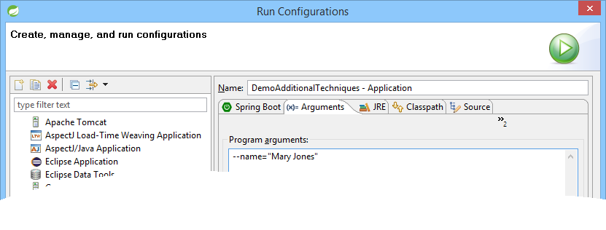

Setting Properties at the Command-Line (2)
Here's how to specify a command-line property using STS

Slide 8
Specifying a Properties File (1 of 3)
SpringApplication looks in the following locations to find properties files:
A /config subdirectory of the current directory
The current directory
A classpath /config package
The classpath root
The list is ordered by precedence
Properties defined in locations higher in the list override those defined in lower locations

Slide 9
Specifying a Properties File (2 of 3)
You can tell SpringApplication to use a different properties file
Set the spring.config.name system property
Or set the SPRING_CONFIG_NAME environment variable
You can specify a properties file programmatically
This example specifies a properties file named "another"
You can achieve the same effect via a command-line arg
@SpringBootApplication
public class Application {
public static void main(String[] args) {
System.setProperty("spring.config.name", "another");
ApplicationContext ctx = SpringApplication.run(Application.class, args);
…
name=Bill Jones
another.properties
--spring.config.name=another

Slide 10
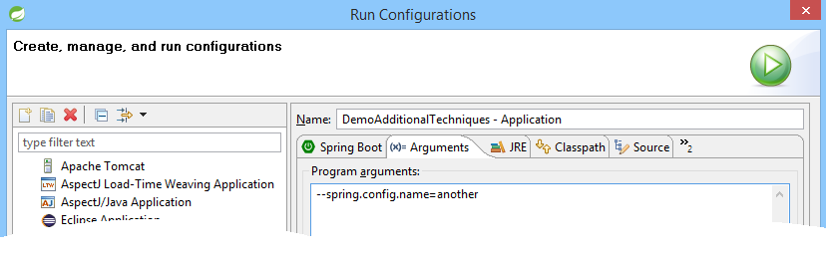
Specifying a Properties File (3 of 3)
This screenshot shows how to specify a properties file via a command-line argument using STS

Slide 11
Defining Properties in a YAML File
YAML is an alternative to properties files
Convenient format for specifying hierarchical configuration data
Here's an example in the demo project:
SpringApplication automatically supports YAML as an alternative to properties
You must have the SnakeYAML library on your classpath
The spring-boot-starter dependency does this automatically
contact:
tel: 555-111-2222
email: contact@mydomain.com
web: http://mydomain.com
another.yml

Slide 12
Using YAML Properties in Beans (1 of 2)
Here's one way to use YAML properties in a bean:
package demo.additionaltechniques;
import org.springframework.stereotype.Component;
import org.springframework.context.annotation.Lazy;
import org.springframework.beans.factory.annotation.Value;
@Component
@Lazy
public class MyBean2a {
@Value("${contact.tel}")
private String tel;
@Value("${contact.email}")
private String email;
@Value("${contact.web}")
private String web;
@Override
public String toString() {
return String.format("tel: %s, email: %s, web: %s", tel, email, web );
}
}
MyBean2a.java

Slide 13
Using YAML Properties in Beans (2 of 2)
Here's another way to use YAML properties in a bean:
package demo.additionaltechniques;
import org.springframework.stereotype.Component;
import org.springframework.context.annotation.Lazy;
import org.springframework.boot.context.properties.ConfigurationProperties;
@Component
@Lazy
@ConfigurationProperties(prefix="contact")
public class MyBean2b {
private String tel;
private String email;
private String web;
@Override
public String toString() {
return String.format("tel: %s, email: %s, web: %s", tel, email, web);
}
// Plus getters and setters.
…
}
Annotate bean with @ConfigurationProperties,
specifying prefix for property names in YAML file
No need to annotate fields with @Value - the values
are bound automatically, based on variable names
Define getters and setters, to facilitate data binding
MyBean2b.java

Slide 14
2. Spring Profiles
Overview of profiles
Specifying profiles for a configuration class
Setting the active profile
Running the application
Defining profile-specific properties
Using profile-specific properties
Running the application

Slide 15
Overview of Profiles
Spring Profiles provide a way to segregate parts of your application configuration
So the configuration is only available in certain environments
E.g. development profile vs. production profile
You can annotate any component or configuration class with @Profile
See next slide for an example

Slide 16
Specifying Profiles for a Configuration Class
Annotate configuration classes with @Profile
public interface MyBean3 {}
MyBean3.java
@Component
@Lazy
@Profile("development")
public class MyBean3Dev implements MyBean3 {
@Override
public String toString() {
return "Hello from MyBean3Dev";
}
}
MyBean3Dev.java
@Component
@Lazy
@Profile("production")
public class MyBean3Prod implements MyBean3 {
@Override
public String toString() {
return "Hello from MyBean3Prod";
}
}
MyBean3Prod.java

Slide 17
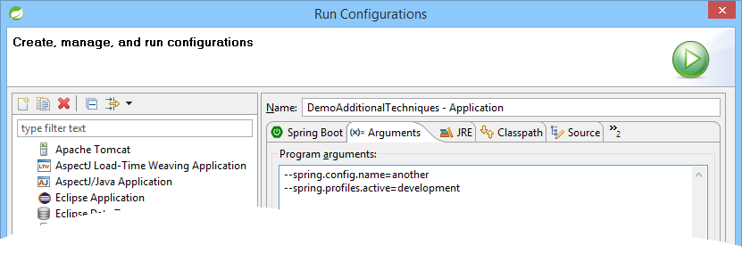
Setting the Active Profile
To set the active profile:
Set the spring.profiles.active environment property
You can do this via a command-line argument:

Slide 18
Running the Application
In the demo "main" class, we get a bean that implements the Bean3 interface
This will either be Bean3Dev or Bean3Prod, depending on the current active profile
package demo.additionaltechniques;
@SpringBootApplication
public class Application {
public static void main(String[] args) {
ApplicationContext ctx = SpringApplication.run(Application.class, args);
…
MyBean3 bean3 = ctx.getBean(MyBean3.class);
System.out.println(bean3);
}
}
Application.java
or

Slide 19
Defining Profile-Specific Properties
You can define profile-specific properties, e.g. in YAML
The --- syntax is the separator between different profiles
1st section defines default values for properties
2nd section defines property values when profile is "development"
3rd section defines property values when profile is "production"
server:
address: 192.168.1.100
port: 8000
---
spring.config.active:
on-profile: development
server:
address: 127.0.0.1
port: 8080
---
spring.config.active:
on-profile: production
server:
address: 192.168.1.120
port: 8888
application.yml

Slide 20
Using Profile-Specific Properties
Just define a configuration class as discussed earlier
The configuration class picks up the appropriate values for the server.address and server.port properties, depending on the current profile
@Component
@Lazy
@ConfigurationProperties(prefix="server")
public class MyBean4 {
private String address;
private String port;
@Override
public String toString() {
return String.format("server.address: %s, server.port: %s", address, port);
}
// Plus getters and setters (these ARE necessary!)
// …
}
MyBean4.java

Slide 21
Running the Application
In the demo "main" class, we get Bean4
Its property values will depend on the current profile
package demo.additionaltechniques;
@SpringBootApplication
public class Application {
public static void main(String[] args) {
ApplicationContext ctx = SpringApplication.run(Application.class, args);
…
MyBean4 bean4 = ctx.getBean(MyBean4.class);
System.out.println(bean4);
}
}
Application.java
one of the following…

Slide 22
3. Spring Boot Actuator
Overview of Spring Boot Actuator
Adding the Actuator pom dependency
Enabling Actuator endpoints
Viewing available endpoints
Health monitoring
Gathering metrics
Demo project:
DemoSpringBootActuator

Slide 23
Overview of Spring Boot Actuator
Spring Boot Actuator is a sub-project of Spring Boot
Includes a number of additional features to help you monitor and manage your application when it’s pushed to production
You can manage and monitor your application using:
HTTP endpoints
JMX
Remote shell (SSH or Telnet)

Slide 24
Adding the Actuator Pom Dependency
The simplest way to enable the Actuator is to add spring-boot-starter-actuator to your POM file
<dependencies>
<dependency>
<groupId>org.springframework.boot</groupId>
<artifactId>spring-boot-starter-actuator</artifactId>
</dependency>
…
</dependencies>

Slide 25
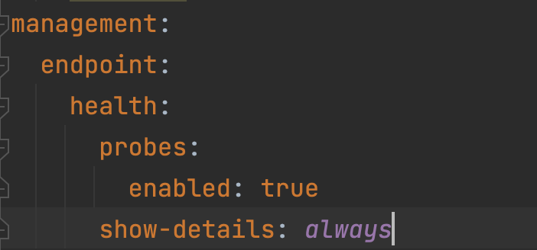
Enabling Actuator Endpoints
From version 2 onwards, Spring Boot Actuator only has the following endpoints enabled by default:
/actuator/health
/actuator/info
To enable other Spring Boot Actuator endpoints, set the following application property:
More on health endpoint:
application.properties
management.endpoints.web.exposure.include=*

Slide 26
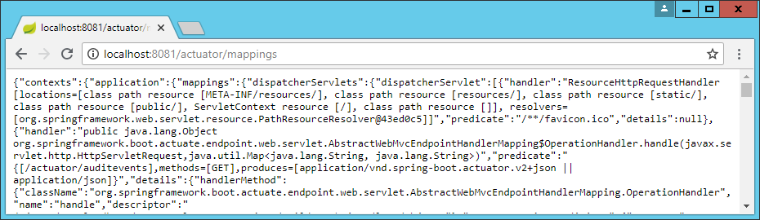
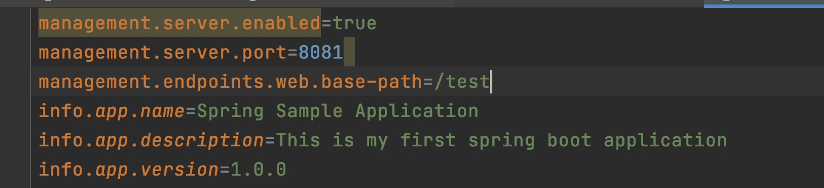
Viewing Available Endpoints
Spring Boot Actuator endpoints allow you to monitor and interact with your application
To see the endpoints: http://localhost:8081/actuator/mappings
If you get a security error, add this to your properties file:
Other management endpoints customisations:
management.security.enabled=false
application.properties

Slide 27
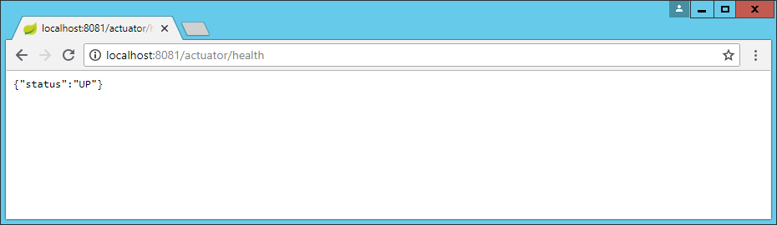
Health Monitoring
The health endpoint provides basic application health information
To get health info, http://localhost:8081/actuator/health

Slide 28
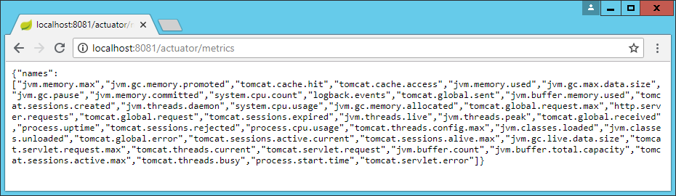
Gathering Metrics
The metrics endpoint provides metrics that can help you identify bottlenecks and to optimize performance.
To get metrics, http://localhost:8081/actuator/metrics

Slide 29
Any Questions?

Slide 30

Exercise
Enhance your application from the previous lab, to make use of properties
Overview (see details on following slides):
Add properties in application.properties
Add properties in application.yml
Add some profile-specific properties
If Time Permits: Use Spring Actuator
Solution
SolutionAdditionalTechniques

Slide 31
Exercise - Step 1
Define and use some simple properties in application.properties
Hints:
Define a property named contactEmail, to hold the company's email address
Inject this value into your CartService class
Write some code to verify the CartService class picks up the value correctly

Slide 32
Exercise - Step 2
Define and use some complex properties in application.yml
Hints:
Create the application.yml file
Define the following properties:
Inject this value into your CartService class
Write some code to verify the CartService class picks up the value correctly
Name of property Value Description
onlineRetailer:salesTaxRate 0.20 Sales tax rate.
onlineRetailer:deliveryCharge:normal 2.50 Delivery charge (GBP) on normal deliveries.
onlineRetailer:deliveryCharge:threshold 3000 Threshold cart value (GBP), for free delivery.

Slide 33
Exercise - Step 3
Add some profile-specific properties
Hints:
Define some properties that have different values depending on the current profile, such as the following:
Define a bean class named ResourcesBean and inject these properties into it
Run the application in "development" profile and "production" profile, and verify the correct values are injected into the ResourcesBean
Name of property Value if "development" profile Value if "production" profile
resources.db H2 Oracle
resources.logs C:\temp\logs\ //PROD_SERVER/logs/
resources.secure false true

Slide 34
Exercise - Step 4 (If Time Permits)
Use Spring Actuator
Hints:
Add support for Spring Actuator in your application
Explore the information made available via Spring Actuator (e.g. health, metrics, etc.)

